Slide 1
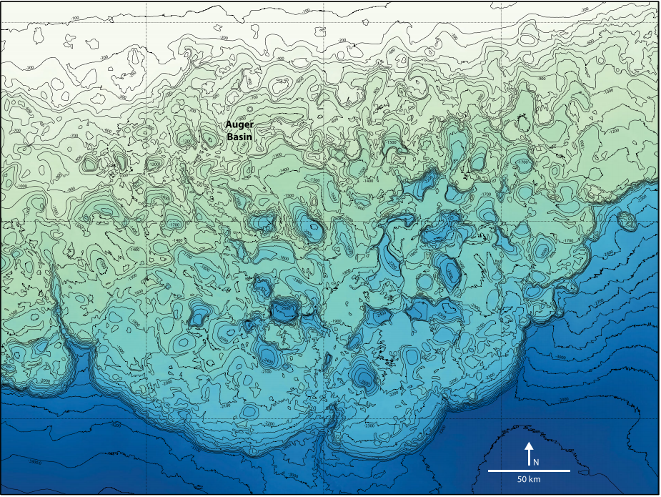
Depositional Evolution of Minibasins: Implication from numerical models
Hang Deng
Final project
April 27, 2016

Slide 2
Abstract
Previous studies emphasized on delineate the basin-scale stratigraphic architecture of salt-withdrawal minibasins. Few studies attempt to analyze how the interplay between basin subsidence and sediment supply generate stratal patterns. Here I present a simplified model to illustrate how different subsidence rates and sediment supply rates generate various stratal patterns (e.g. drape vs axial fills). Such study can be used to compare and contrast with minibasins in Gulf of Mexico for a better understanding of stratigraphic evolution of minibasins.

Slide 3
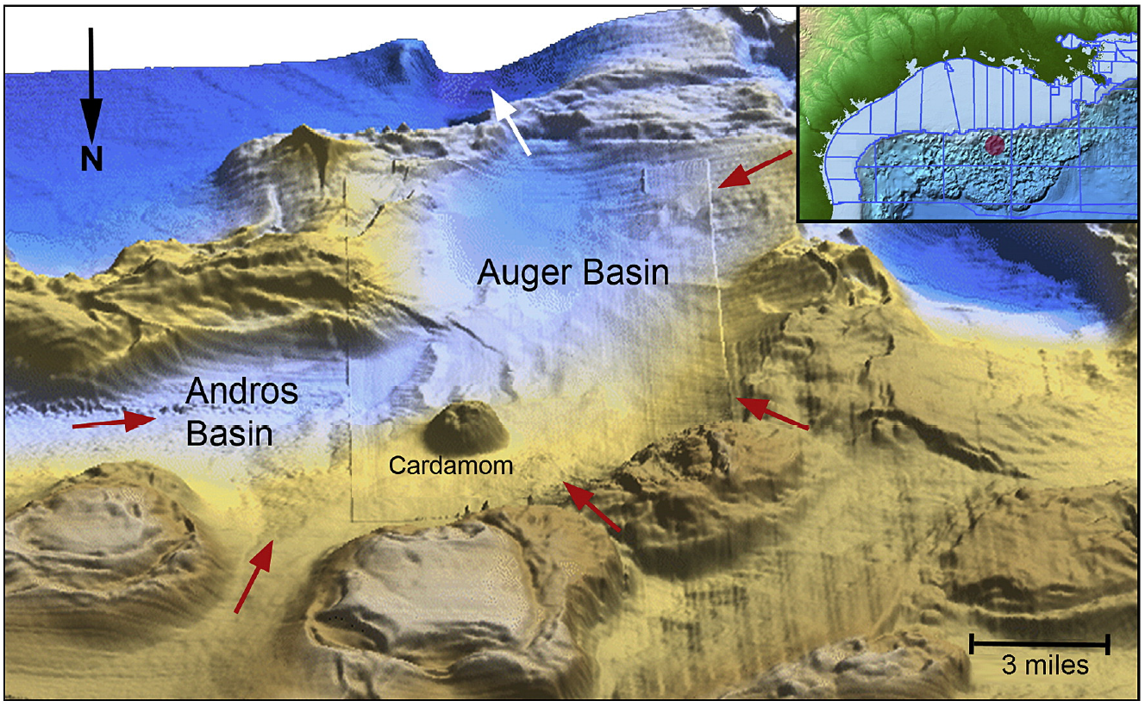
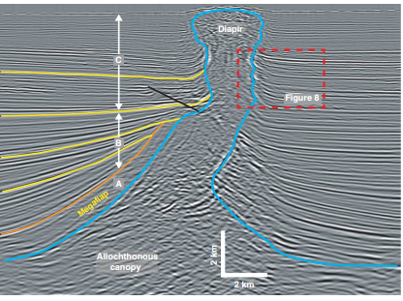
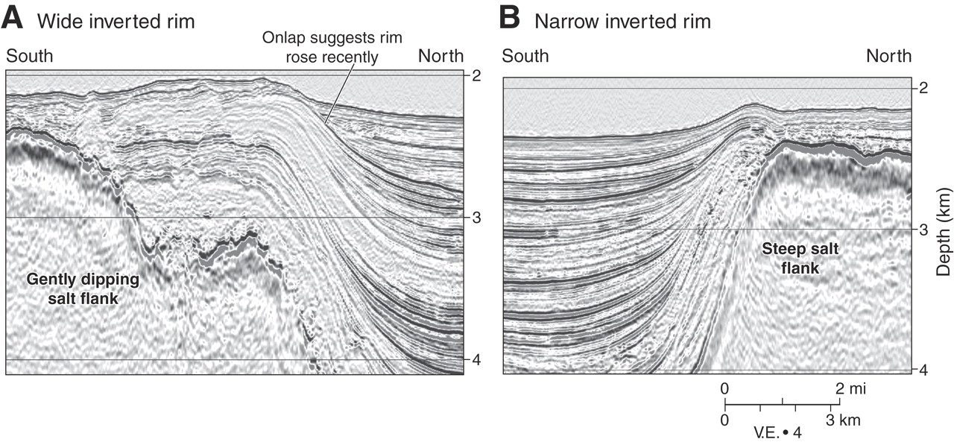
Minibasin in Gulf of Mexico
e.g. Auger field, Gulf of Mexico
Walker Ridge Area
The minibasins in Gulf of Mexico are small bowl-like, elongate depressions on the shelf and slope. The creation of such basins are explained as sediment loading on salts which drives sediment into sinks on salts.
Walker Ridge area, Michael R. Hudec et al. GSA Bulletin 2009

Slide 4
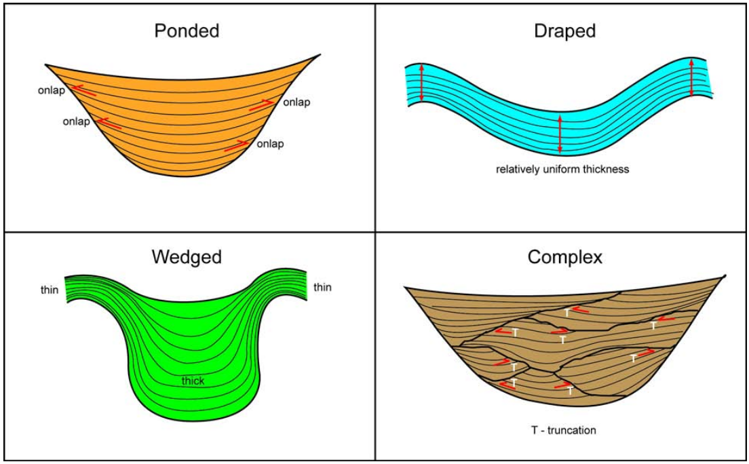
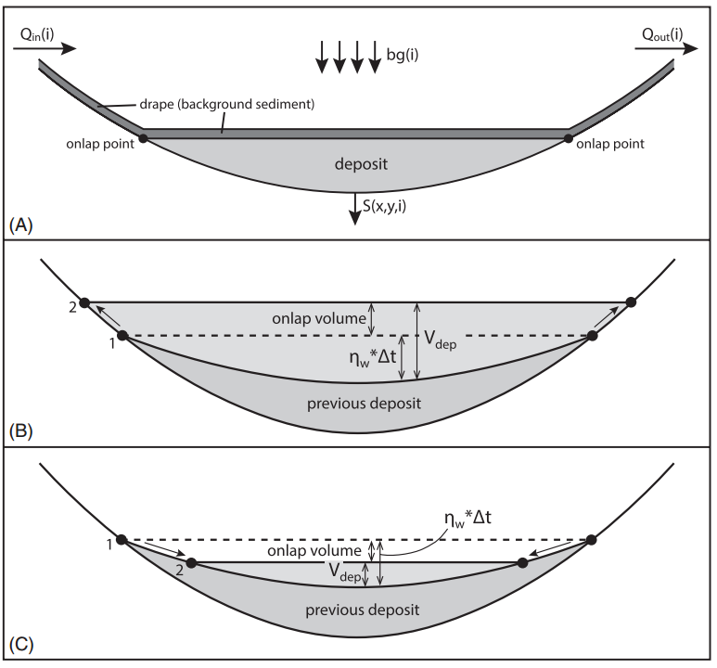
Minibasin Subsidence & sediment supply interplay
Figure from Maharaj’s dissertation, Univ of Texas at Austin
Can we reproduce some of the strata geometry/pattern and analyze what controls led to the specific pattern?
Figure from Sylvester et al., 2014 AAPG Bulletin

Slide 5
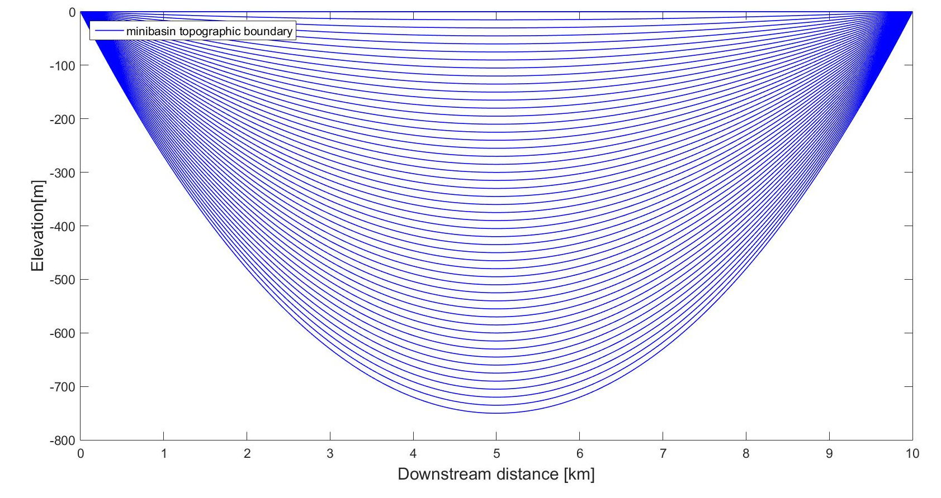
Minibasin Subsidence
Mechanisms:
Maximum subsidence rate: 1.5m/kyrs, 3m/kyrs, 5 m/kyrs.
Maximum subsidence in the center of the minibasin topography.
Subsidence rate decreases towards minibasin edges.

Slide 6
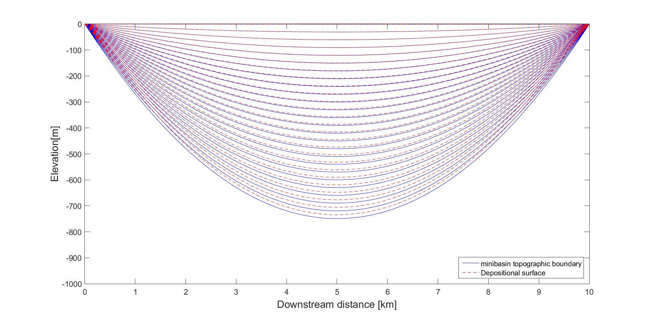
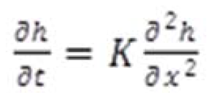
Algorithms in the models
Mechanisms:
Sediment diffusion:
Slope updated from depositional surfaces.
Jordan and Flemings JGR 1991; Jordan and Flemings 1992 Geology

Slide 7
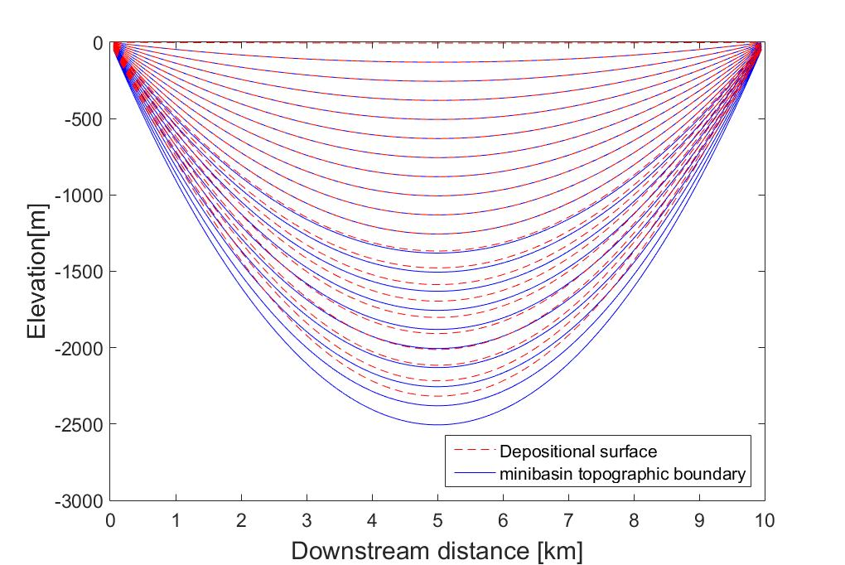
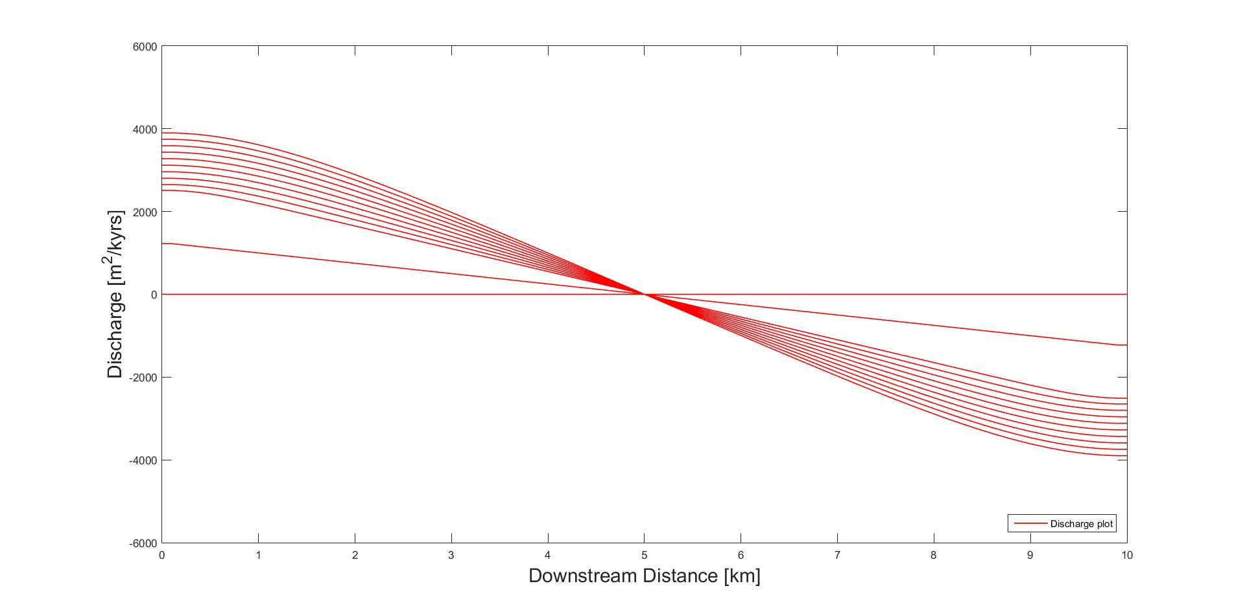
High sediment supply, high subsidence rate, step function
Mechanisms:
Step function in sediment yield: Zero in the first half of running time.
Parabolic erosion rate

Slide 8
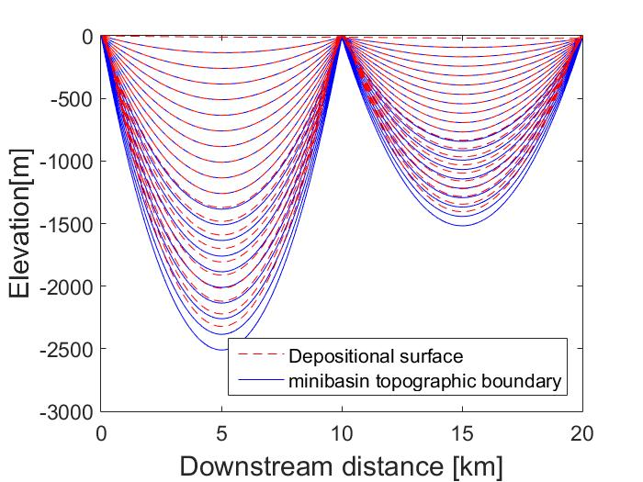
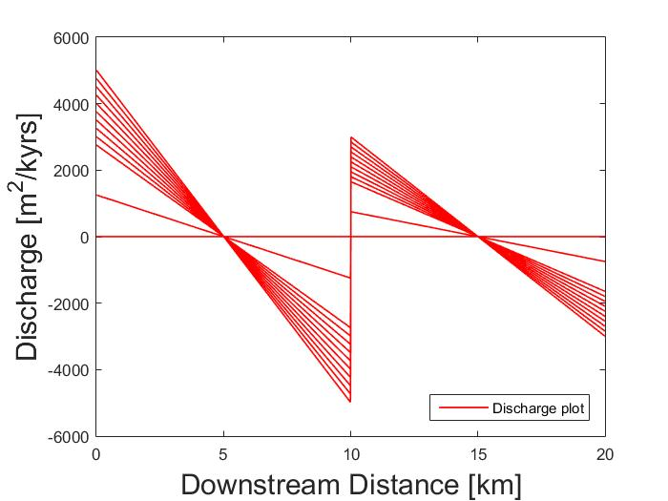
Two adjacent “ponds” with different subsidence rates

Slide 9
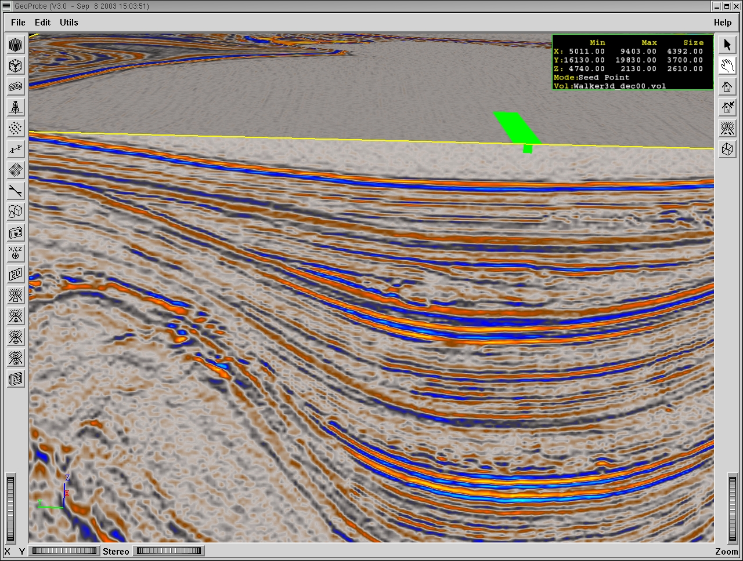
Where do we go from here?
Back to our data in other basins to test the experimental outcomes and modify our approaches.
Drape fill: periods of low relief.
Axial fill: periods of high relief
Mass Transport: reflecting active uplifts.
Incision: dominance of bypass of basin
SF
Drape Fill
Axial Fill
Incision
100
Margin Flank Slumps
Drape Fill
Axial Fill
Drape Fill
Mass Transport
200
Axial Fill
Courtesy of Veritas Marine Surveys, Houston, Texas.
Image courtesy of Vishal Maharaj

